Slide 1
Spring 2020 A2
Group 11

Slide 2
Actors
Group Moderator —Each show or movie has its own landing page and community called a Channel. Moderators of a Channel are each appointed for a specific language and are responsible for taking care of subtitling in their language by recruiting and managing subtitlers, editing, and overseeing the quality of subtitles in their language
Group member—A group member is the prime user in this website. They can join and unsubscribe group, search movies and watch movie trailers, and write and access movie reviews.
Movie List Server—A backend server which is responsible for responding the request from moderator with the information of movie list.
Movie review Server—A backend server which is responsible for responding the request from group member with the information of list of movie reviews.

Slide 3
Use Cases - Group Moderator
Moderator create watcher’s group
Moderator invite other people to join the group
Moderator populate the movie list
Moderator pull movie list from a movie list server
Moderator create a movie watching event
Moderator open or close a voting period

Slide 4
Use Cases - People or Group member
People join the group
People unsubscribe the watcher’s group
People search and browse the movie
People watch the movie trailer
People access the movie review from a movie review server
People vote for watching that movie or not

Slide 5
Use Case ID: 1
Use Case Title: Create a group
Actors: Moderator
Description: This use case starts when a moderator click create a group button in the system website; system request the group information. Moderator enter a unique group name and group description; system accepts the group information. [Exception - Name already exist]. The use case ends when moderator click confirm button; system stores the group information in the database.
Preconditions: A moderator click a create a group button
Postconditions: A watcher group exist in the system.
Steps: Moderator click create button. Then moderator enter the group name and description. Finally, moderator click the confirm button to finish create group.

Slide 6
Use Case ID: 2
Use Case Title: Invite into group
Actors: Moderator
Description: This use case starts when moderator click invite button; system request a member’s username. Moderator enter a username; system accepts the username. [Exception - Name not found]. The use case ends when moderator click send button; system send invite to that member.
Preconditions: A group is exist in the system.
Postconditions: System will send a message to that person
Steps: Moderator click invite button, then enter the username and click send.

Slide 7
Use Case ID: 3
Use Case Title: Populate a movie list
Actors: Moderator
Description: This use case starts when moderator click populate button; system request a list of movies. Moderator enter a list of movie name; system accepts the list. [Exception - Movie not found]. The use case ends when moderator click save button; system stores the list in that group.
Preconditions: A group is exist in the system.
Postconditions: System stores the movie list information in that group
Steps: Moderator click populate button, then enter a list of movie name and click save.

Slide 8
Use Case ID: 4
Use Case Title: Pull a Movie List
Actors: Moderator
Description: This use case starts when moderator click a existed movie list in this group; system request a list of movie name in this list. Moderator can edit the list(delete or add movies[Exception - Movie not found]); system accepts the new list. . The use case ends when moderator click save button; system update the list in that group.
Preconditions: A group is exist in the system. The movie list server is connected.
Postconditions: System stores the movie list information in that group
Steps: moderator click a existed movie list, then edit the movies in the list, and click save button

Slide 9
Use Case ID: 5
Use Case Title: Create a watching event
Actors: Moderator
Description: Moderator can create a watching event for a group on a certain day. The server will receive the request and notice everyone in this group.
Preconditions: A group is exist in the system.
Postconditions: System will send a message to every people in that group
Steps: Moderator click create a watching event, and then input data including which data,which group, which movie list, and submit the creating.

Slide 10
Use Case ID: 6
Use Case Title: Open or close vote
Actors: Moderator
Description: Moderator could select an event and create a vote in it, including choose movies in the movies list, start date, end date. The server will receive the request and notice everyone in the group. Moderator also can get in the event, and click the vote and close it early.
Preconditions: A group is exist in the system. A watching event is created.
Postconditions: System will send a message to every people in that group.
Steps: Moderator click the specific event, in this event moderator can post a vote on which movie people want to watch, and then select some movies in the movie list, and start date, end date, and submit, then server will receive the request and notice everyone in the group. Also moderator could get in the event, click the vote and close it.

Slide 11
Use Case ID: 7
Use Case Title: Join in a group
Actors: Member
Description: search a group or find one in recommond list, user can click the group to select join this group, then the server will process the request and add the user to the group.
Preconditions: A group is exist in the system.
Postconditions: System store that person information in that group.
Steps: user click a group and select join button in the menu, then the join request will be sent to server, the server store the user data in the group.

Slide 12
Use Case ID: 8
Use Case Title: Unsubscribe a group
Actors: Member
Description: This use case starts when members do not want to be part of group. Members click the button of unsubscribe a group. Then system remove the member information from that group and cancels all member permissions in that group.
Preconditions: A group is exist in the system. Member is in that group.
Postconditions: System remove the member information from that group.
Steps: Members click button of subscribe a group. system remove the member information from that group and cancels all member permissions in that group.

Slide 13
Use Case ID: 9
Use Case Title: Access the movie review
Actors: Member
Description: This use case starts when members click the button of movie review. System sends the request to movie review server. Movie review server send the response message to system and then system show these response message to members.
Preconditions: The member is in a group.
Postconditions: System show the response message from the movie review server to member
Steps: Members click the button of movie review, system sends the request to movie review server. Then movie review server send the response message to system and system show the response message to members.

Slide 14
Use Case ID: 10
Use Case Title: Search and browse the movie
Actors: Member
Description: This use case only happens to members who are already in a group. Members enter keywords what they want to search in search bar and then system will show all results related to keywords.
Preconditions: The member is in a group.
Postconditions: System show result to the member
Steps: Members enter keywords in search bar, system shows results related to keywords.

Slide 15
Use Case ID: 11
Use Case Title: Watch the movie trailer
Actors: Member
Description: member click the movie trailer populated by moderator, then the member can watch the video.
Preconditions: The member is in a group. The movie has been populate by moderator.
Postconditions: System will send the link of trailer to that member.
Steps: member click the trailer, and send a request to server, the server will responds a video streaming flow to member so that he/she can watch the trailer.

Slide 16
Use Case ID: 12
Use Case Title: Vote a movie
Actors: Member
Description: When a vote is open, every member in the group can vote for one or some movies.
Preconditions: The member is in a group. A watching event is created by moderator. A vote is opened by moderator.
Postconditions: System store the vote count for that movie.
Steps: When a vote has been posted, member can get in event,and then click the vote, and then choose one or some movies, and vote.

Slide 17
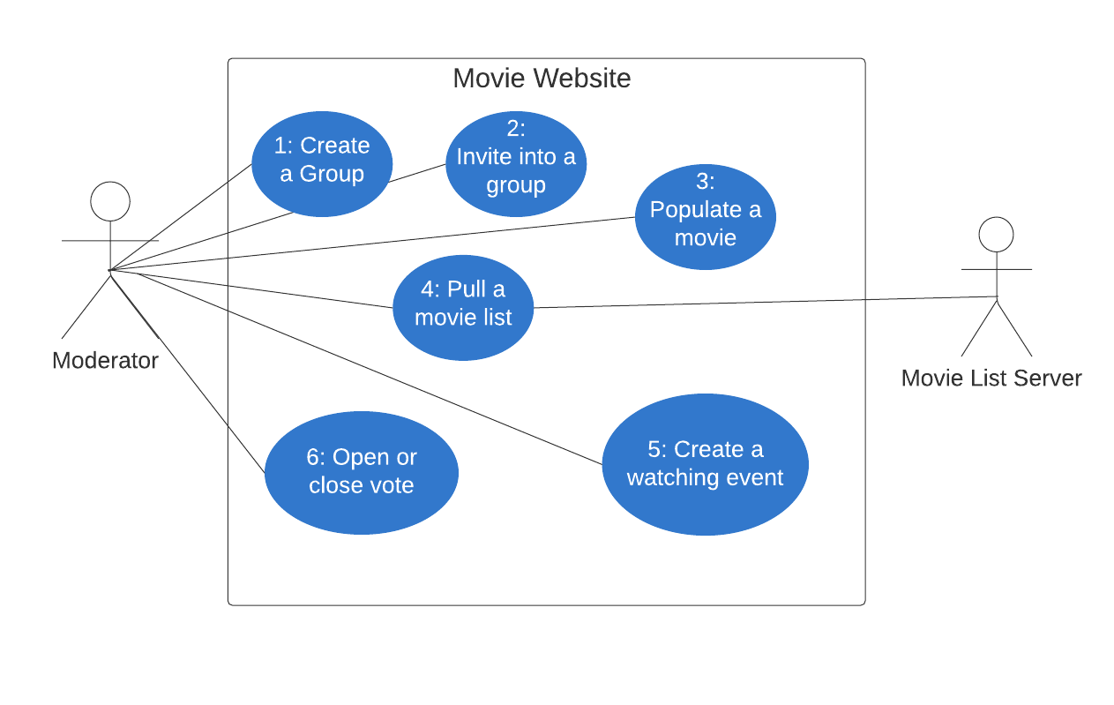
Moderator Use Case Diagram

Slide 18
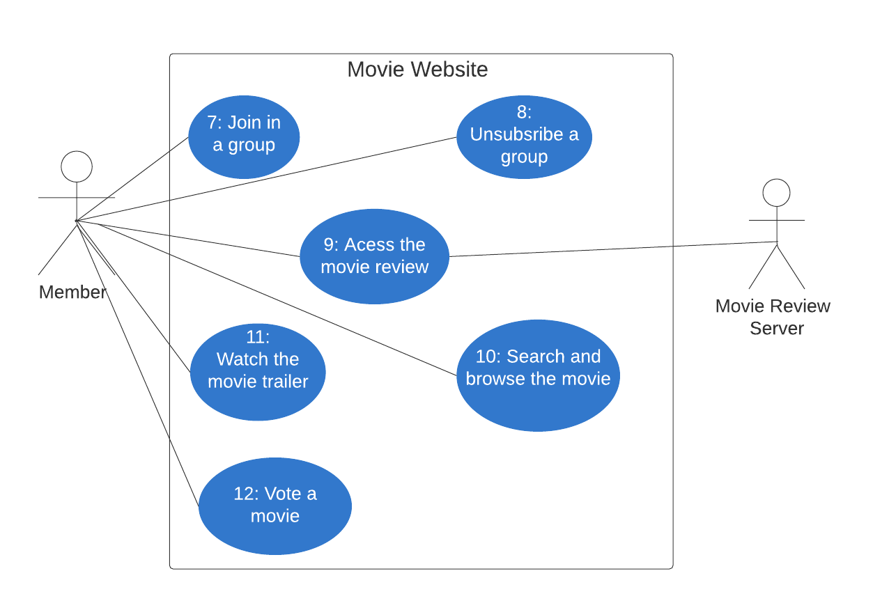
Member Use Case Diagram

